Slide 1
Computational Quantum Mechanics
Prof. Gerson J. Ferreira
INFIS/UFU 2020/1
The shooting method
https://gitlab.com/gersonjferreira/computational-quantum-mechanics

Slide 2
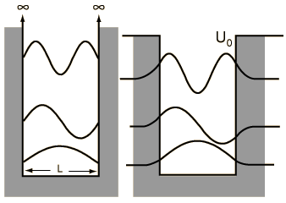
The problem
Goal:
→ Solve the 1D time-independent Schrödinger equation with the shooting method
Boundary value problem (BVP)
→ but the shooting method
is for initial value problems (IVP)

Slide 3
The trick
→ write the Schrödinger equation as an IVP and try to find a solution that satisfies the BVP
1. Choose an guess for E
2. Use Euler / RK4 / Numerov to propagate from 0 to L
3. Check if |ψ(L)| < ε, assuming small, e.g. ε ~ 10⁻⁶
4. If not, guess E again and loop
→ how to guess E? Bisection, Newton, Numerov-Cooley
How to choose s? Any choice of s ≠ 0 is valid,
since it will be renormalized at the end.

Slide 4

The propagation from 0 to L:
0
a
L
i=0 1 2 3 4 5 6 … N-1
The 2nd derivative in finite differences with step size a is
Apply to the Schrödinger equation and isolate ψi+1
Use the initial conditions from the IVP:
← got this one using the forward difference

Slide 5
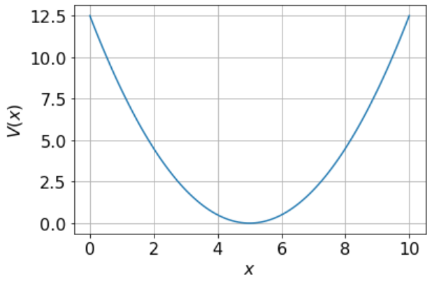
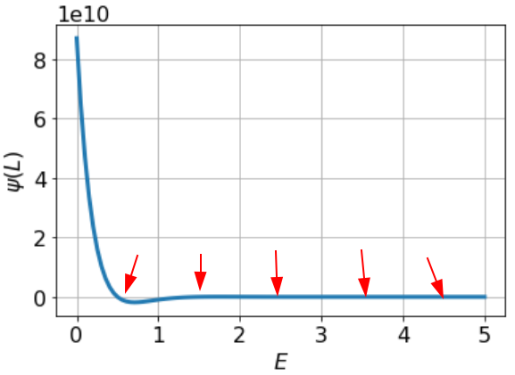
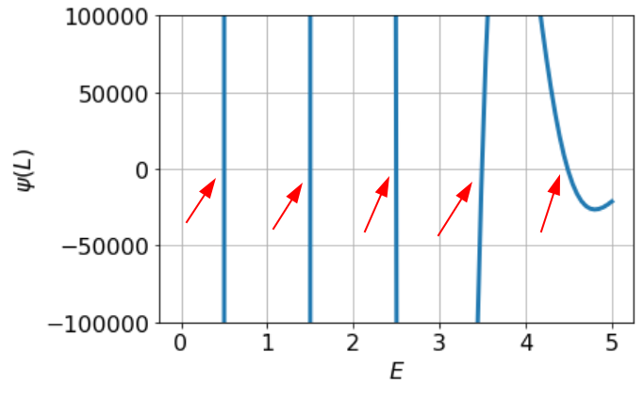
Implementation
Let’s consider ħ = m = 1
→ L = 10, x = [0, L], discretized with N = 100 points
→ V(x) = ½ (x-L/2)²
We expect eigenenergies at E = (n+1/2)ħω, with ħω = 1
For each E, propagate the solution and plot ψ(L) vs E
zoom

Slide 6
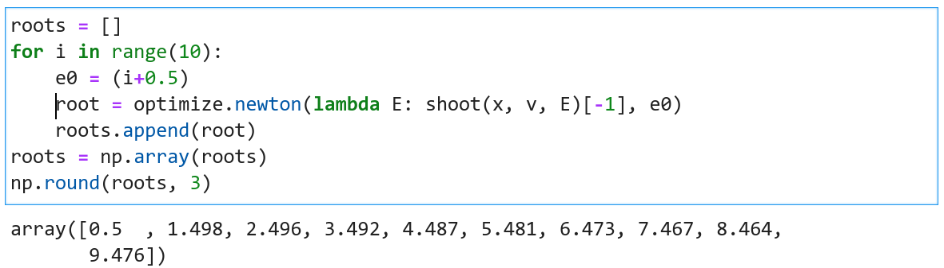
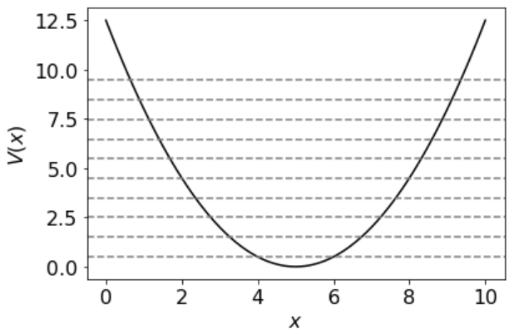
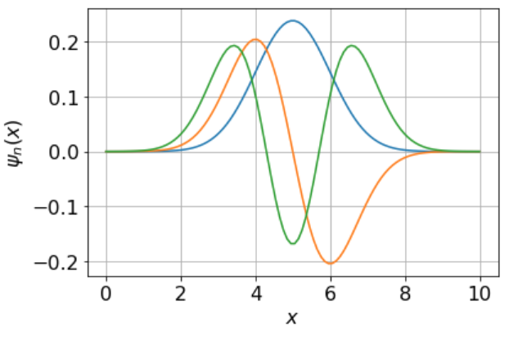
Using Newton’s method

